Slide 1
User Behavior Analysis
2025-08-04
Rian Firmansyah

Slide 2
Agenda
Objective and Approach
Data Overview
User Profile and Segmentation
Transaction Behavior
Risk Signals (Cards) & Engagement and Opportunity
Insight & Recommendations

Slide 3
Objective and Approach
Understand user segmentation, risk, engagement, and churn
Data sources & methodology: SQL + Visualization + Dashboard
?
!

Slide 4

Data Overview
User_Data
Transactions
Card
Contains demographic and profile information about each customer, including age, gender, location, income, and credit score.
Holds detailed records of customer transactions such as transaction date, amount, merchant information, and whether a chip was used.
Stores information about issued cards, including card type, brand, credit limit, expiry date, and risk indicators like dark web exposure*.

Slide 5

User Segmentation
Income & credit score buckets
User Income Distribution
Users with low income contribute more overall compared to mid- and high-income groups, while the majority fall into the "Good" credit segment, which is higher than other segments.
User Demographic
User gender distribution is fairly balanced, with females slightly leading at 50.1%. The majority of users belong to the Millennial generation.

Slide 6

Transaction Behavior
Volume & value trends
Total Spent Trend
Spending is highly volatile with frequent peaks, likely driven by promotions or seasonal events. Baseline daily spending ranges from 300K–1M, with occasional spikes up to 2.5M.
Chip vs non-chip usage
Swipe transactions dominate in count (6.96M) and total spend (28.7M), while online transactions have the highest average spend per transaction (57). Chip transactions show strong volume but lower average spend.
Top merchants / cities
Offline merchants dominate in count, with Houston leading in merchant presence. However, online merchants drive the highest total transaction amount (88.9M), far surpassing any single city.

Slide 7
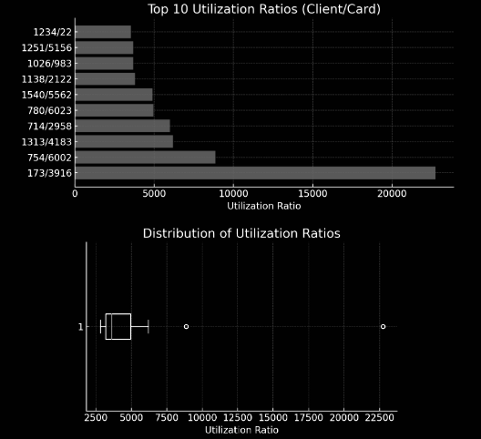
Risk Signals (Cards)
Utilization ratios
Risk Card Distributions
A small subset of users shows disproportionately high utilization—investigate for risk (e.g., potential credit stress or fraud) while monitoring the bulk for healthy usage.
Users with many cards but low credit score
Some users have relatively low credit scores (around 480–560) despite holding multiple cards with substantial average limits, indicating potential credit overextension or gaps in risk-based credit assignment.

Slide 8
Engagement and Opportunity
High-income users with little or no card activity, especially those showing declining transaction frequency, are at elevated churn risk despite strong revenue potential.

Slide 9
Next steps
Things to consider to do next..
Targeted engagement: reactivation untuk high-income low-activity
Loyalty/reward untuk healthy utilization patterns

Slide 10
Thank you
Feel Free to give feedback
Rian Firmansyah
rianfirmsy@gmail.com
+62 812 9713 9796

Slide 11
Appendix
https://github.com/rianfirmsy1886/user-behavior-analysis
Gsheet Link

